Slide 1
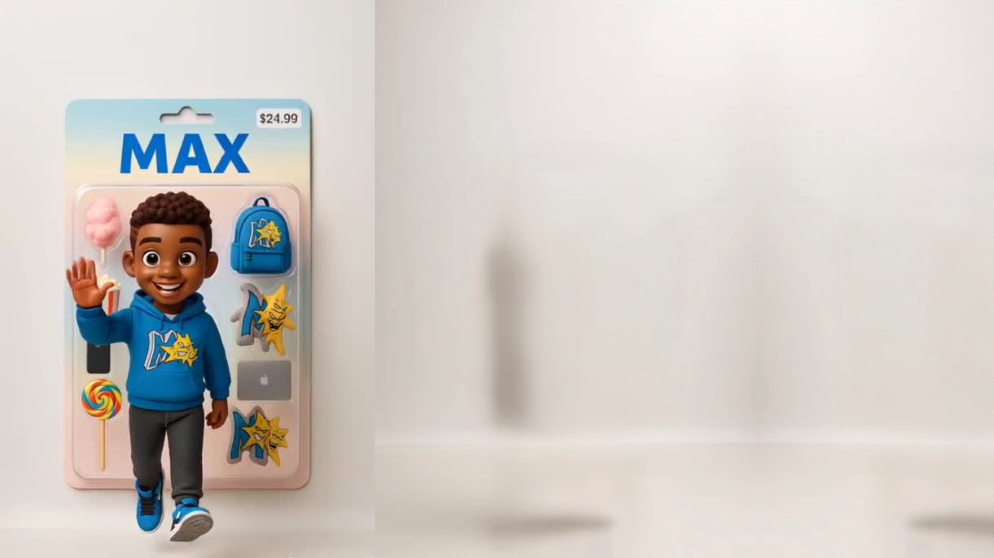
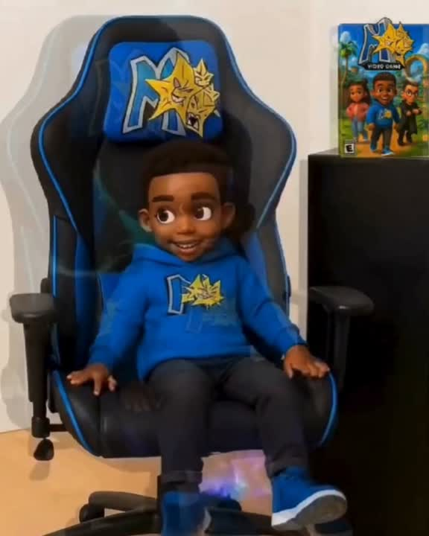
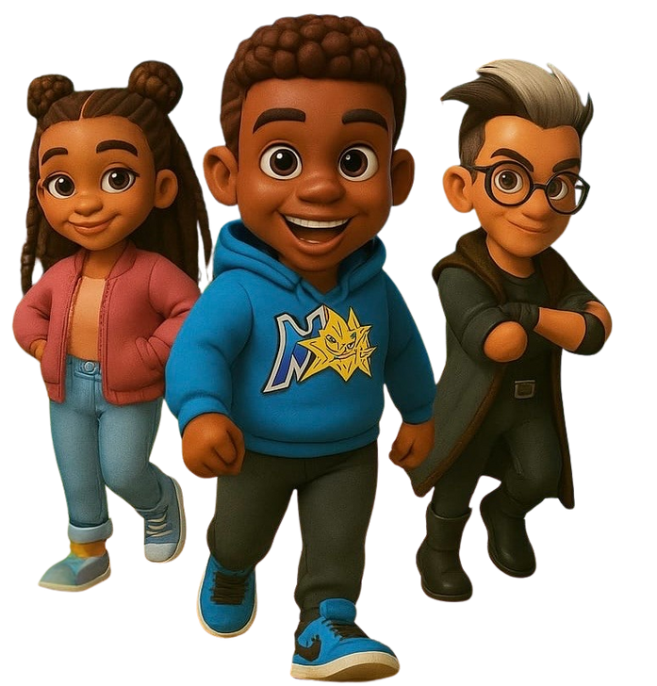
Making
Sure
They
All
Reach
Success
MSTARS is an emerging brand
of confidence created to uplift and empower the youth.
Notes:
1

Slide 2
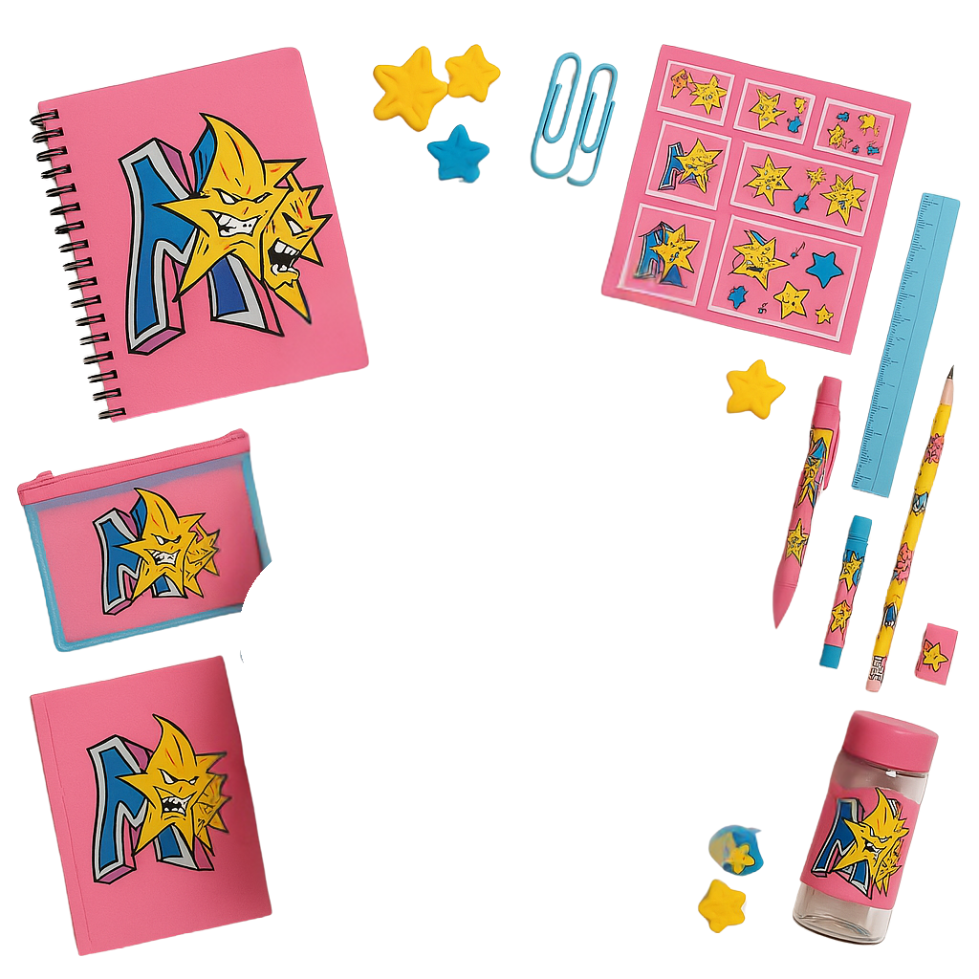
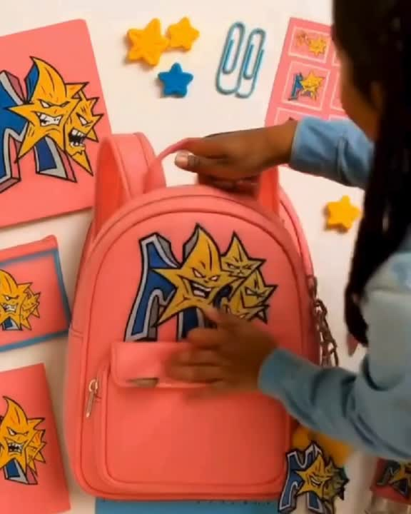
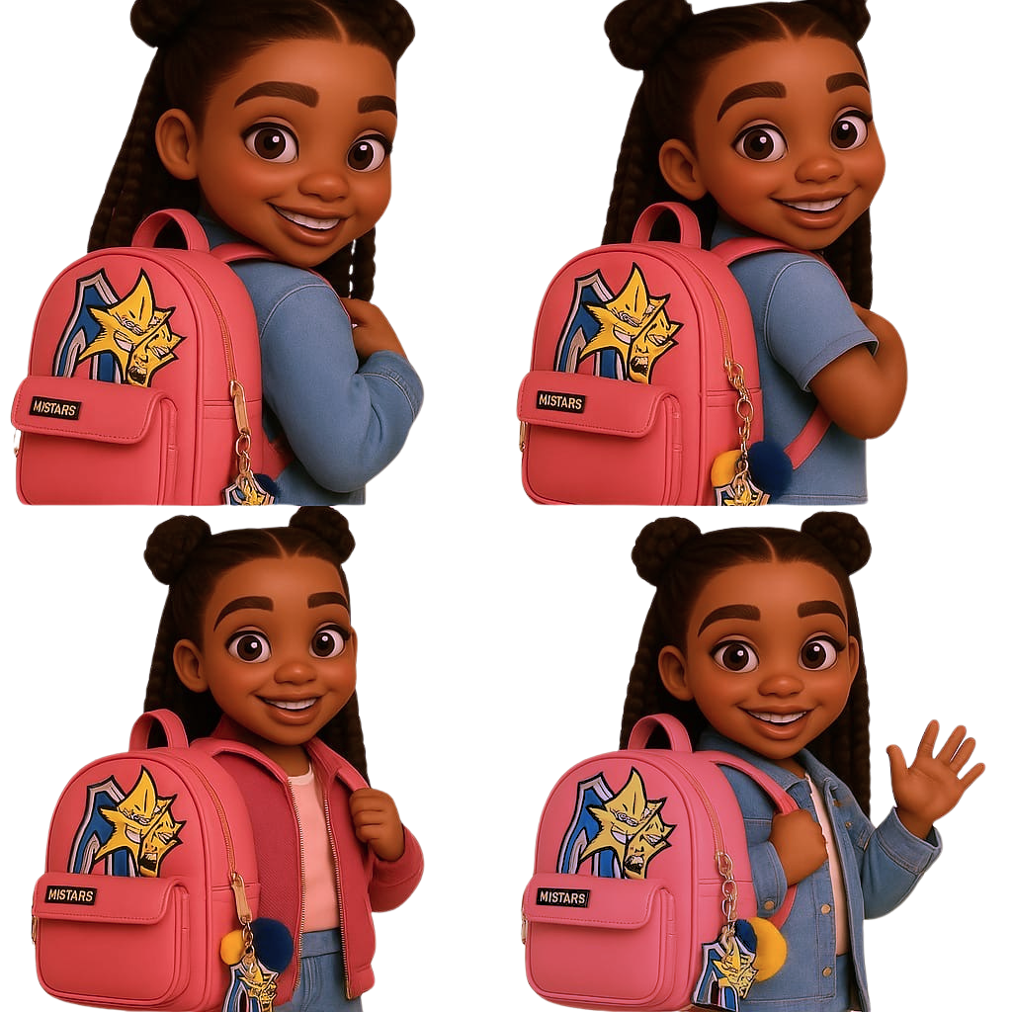
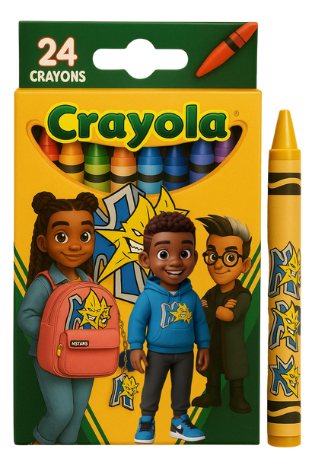
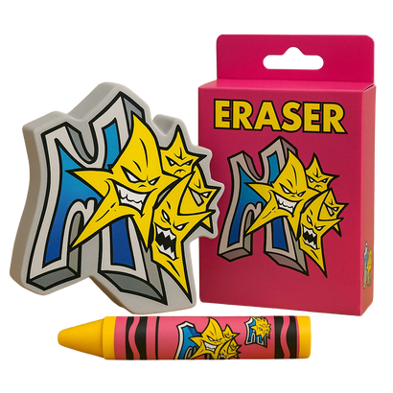
Through powerful characters like Max and Sam, bold storytelling featuring adventures against figures like Dr. Eclipso, and innovative confidence-driven products, MSTARS is more than just a brand—it’s a belief and a movement. We ensure every child feels seen, valued, and empowered to reach success.
*concept
Notes:
2

Slide 3
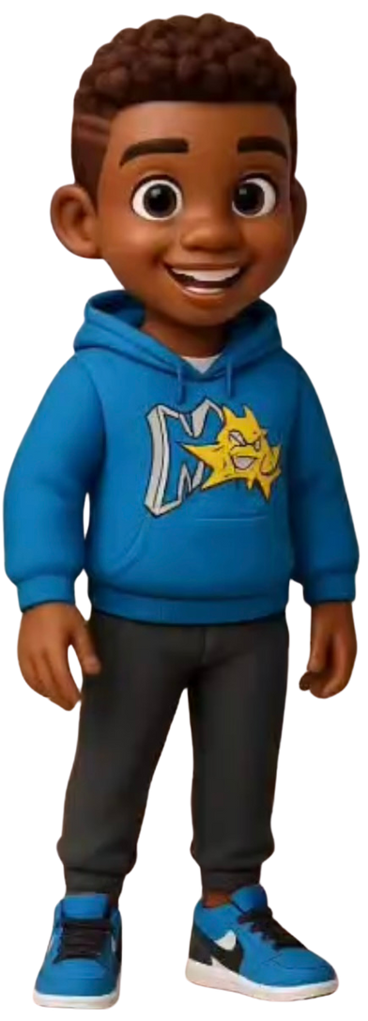

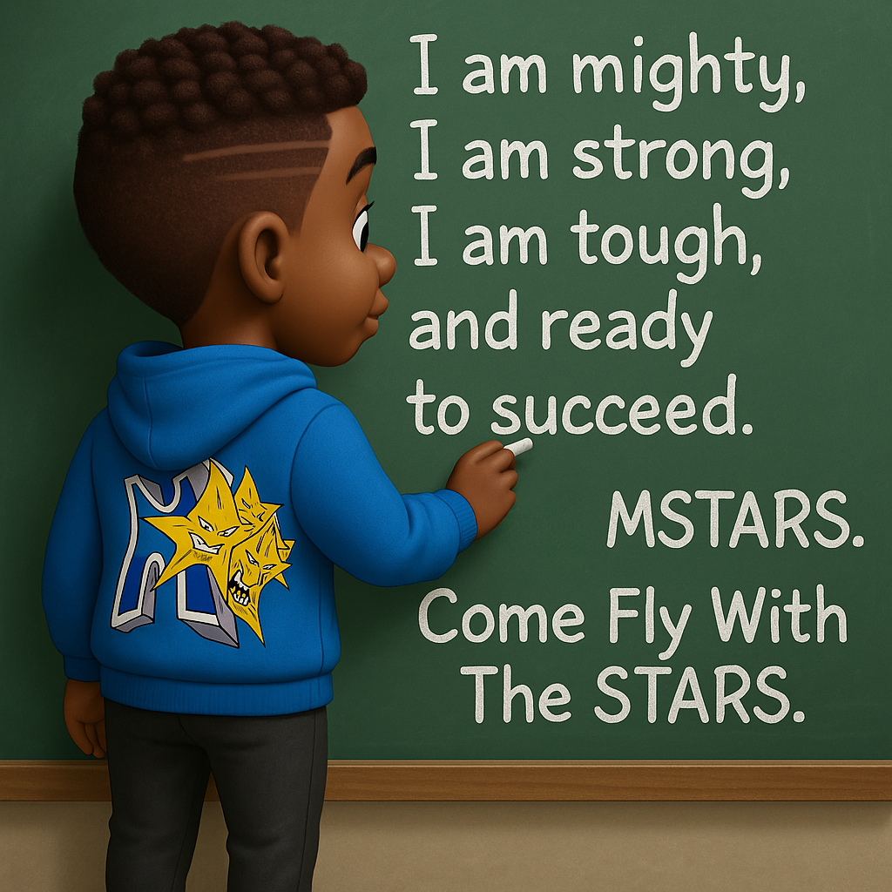
Daily Affirmations
Now it’s your turn.
Say it with me!
“I am mighty, I am strong, I am tough, I am able and ready to succeed. MSTARS. Come Fly With The STARS.”
Notes:
11

Slide 4

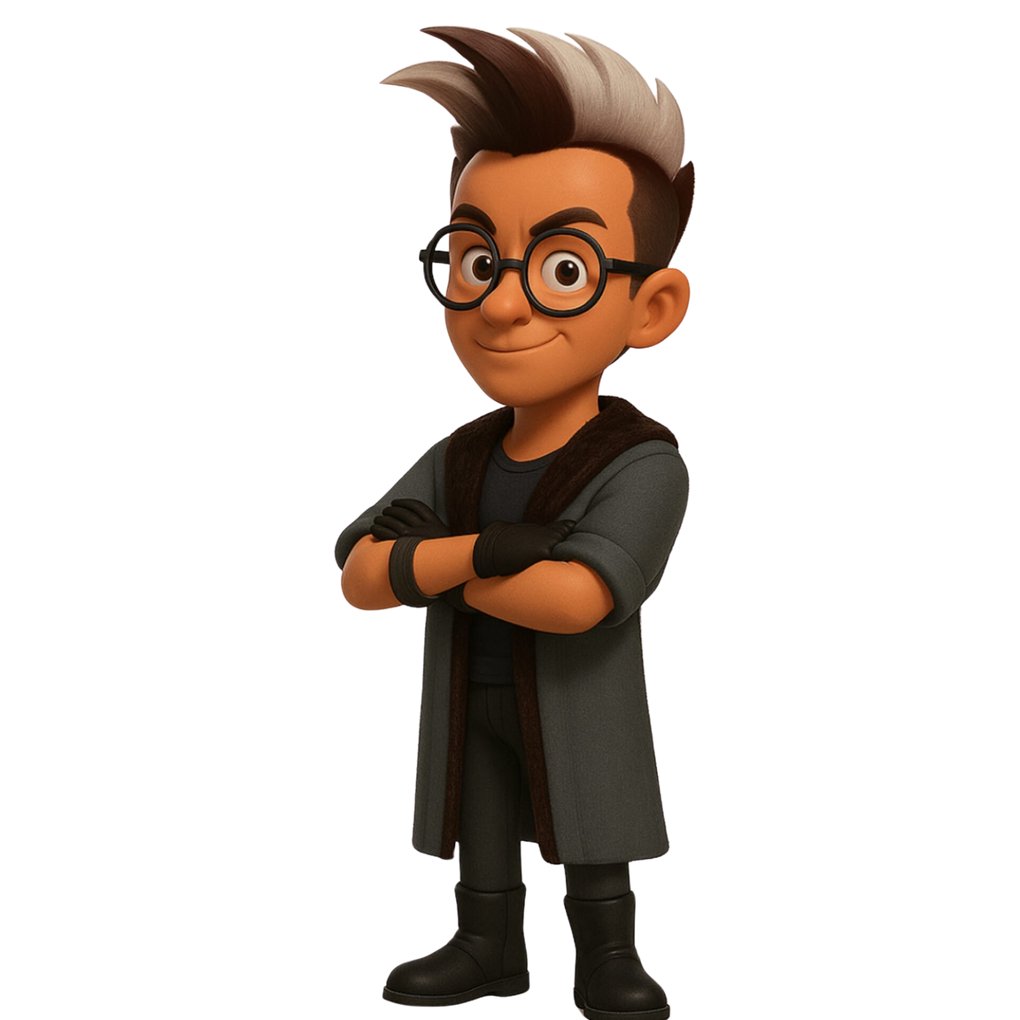
Brand Overview
At MSTARS, we envision a world where every child recognizes their inherent value and boundless potential. Our approach combines engaging narratives, innovative interactive media, and empowering products designed to resonate deeply, reinforcing each child’s sense of worth and belonging. MSTARS is more than a brand; it’s a movement championing empathy, inclusivity, and authenticity, ensuring every child confidently reaches success.
COME FLY WITH THE STARS!!!
Notes:
3

Slide 5
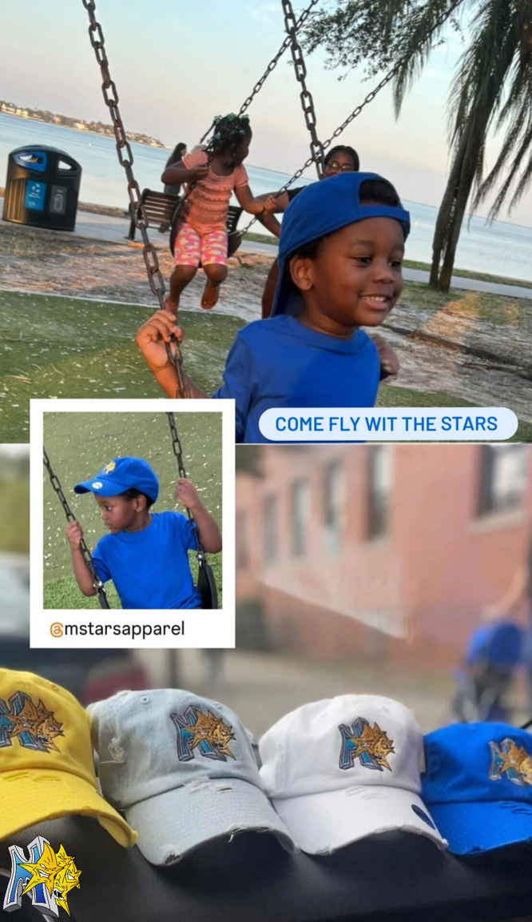
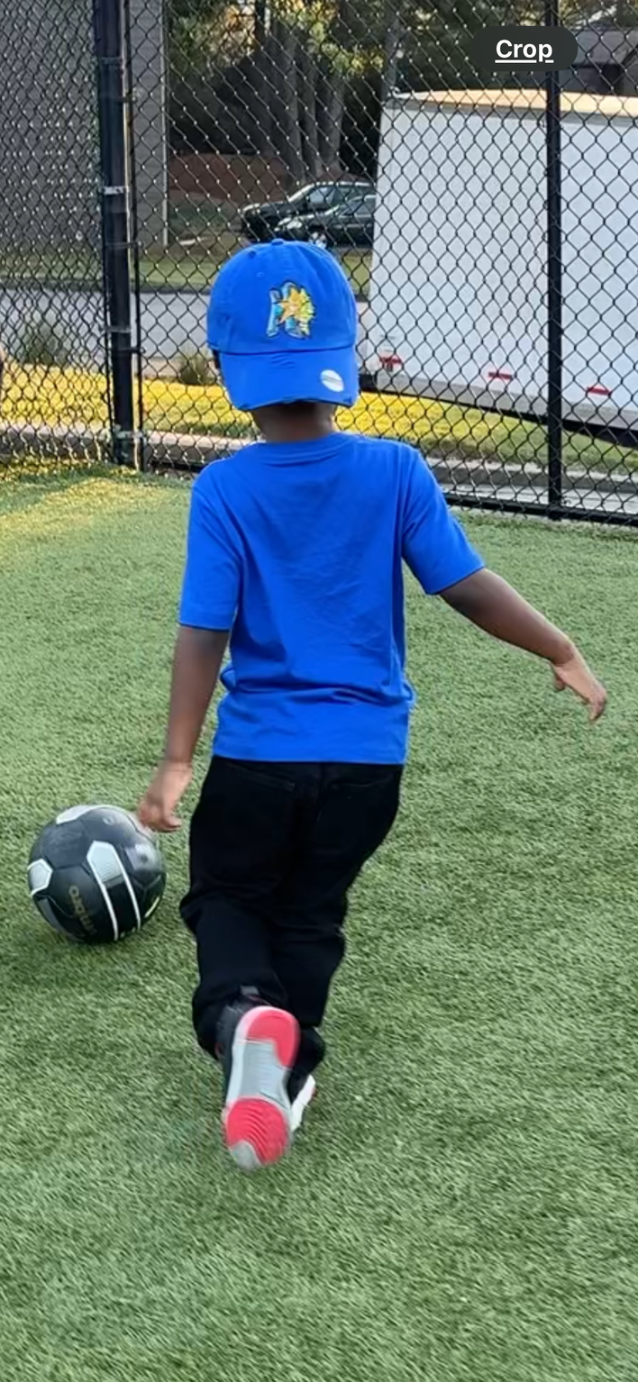
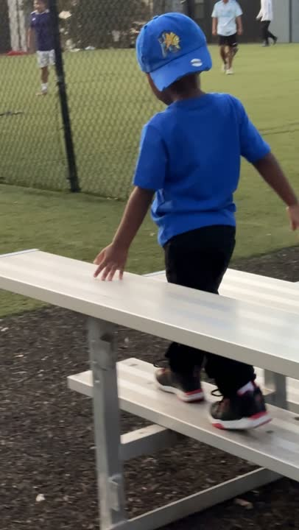
Our Why
Kids often grow up feeling unseen
ADHD, on the spectrum, introverted, or misunderstood—they're often pushed to the side.
MSTARS was created to empower
To make sure they feel powerful, capable, and proud of who they are and embrace their SUPER POWERS.
MSTARS is dedicated to uplifting and empowering children who often feel neglected, ensuring they can embrace their unique identities and reach their full potential.
Notes:
4

Slide 6
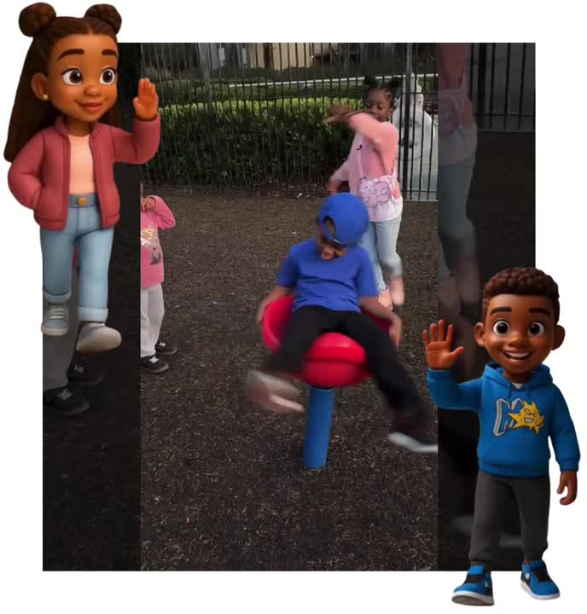
Our Mission
MSTARS mission is to help children believe in their greatness, feel confident in their identity, and know they are worthy of success. We are dedicated to ensuring that all children, especially those who are often ignored or marginalized, can reach their full potential and soar.
Notes:
5

Slide 7
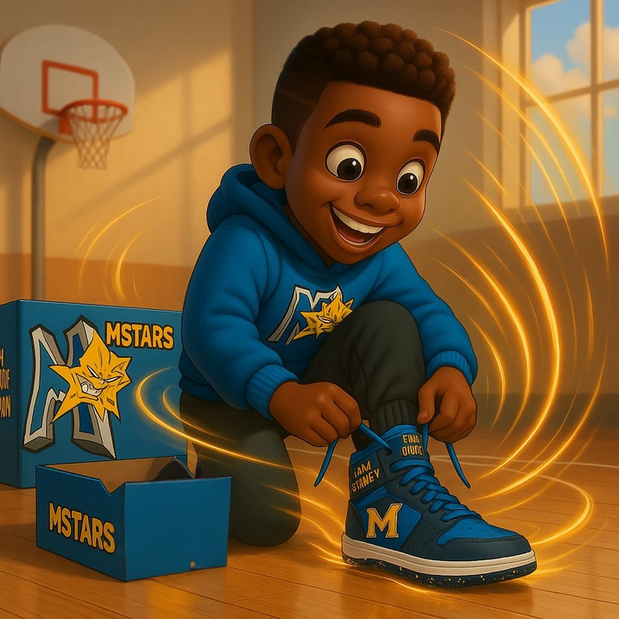
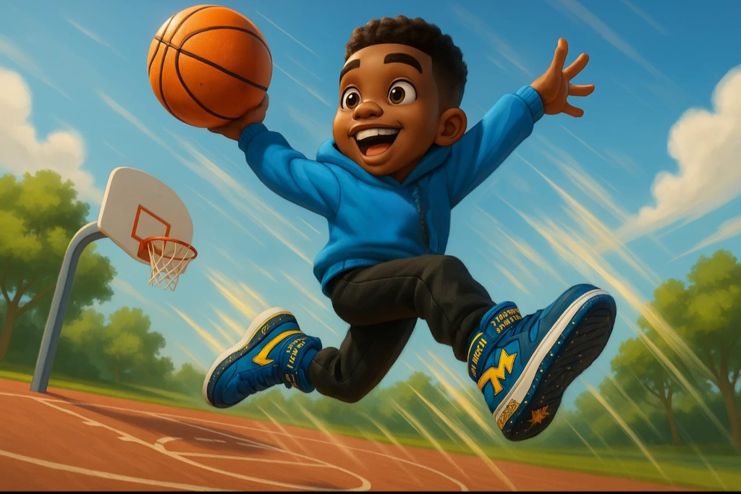
Our Vision
Every child is represented
  MSTARS celebrates the diversity of children, ensuring that all young individuals, regardless of their background or identity, feel seen, heard, and valued.
Every child is confident
  MSTARS aims to empower children to believe in themselves and their abilities, helping them overcome any doubts or insecurities.
Every child is inspired
The brand seeks to ignite a sense of inspiration and wonder in children, encouraging them to explore their passions and reach new heights.
MSTARS stands for the misfits, the quiet ones
  The brand caters to children who may not fit the traditional mold, providing them with the support and resources they need to thrive and shine.
Believe they can fly
  MSTARS empowers children to reach for the stars, to dream big, and to believe that they can accomplish anything they set their minds to.
Notes:
6

Slide 8
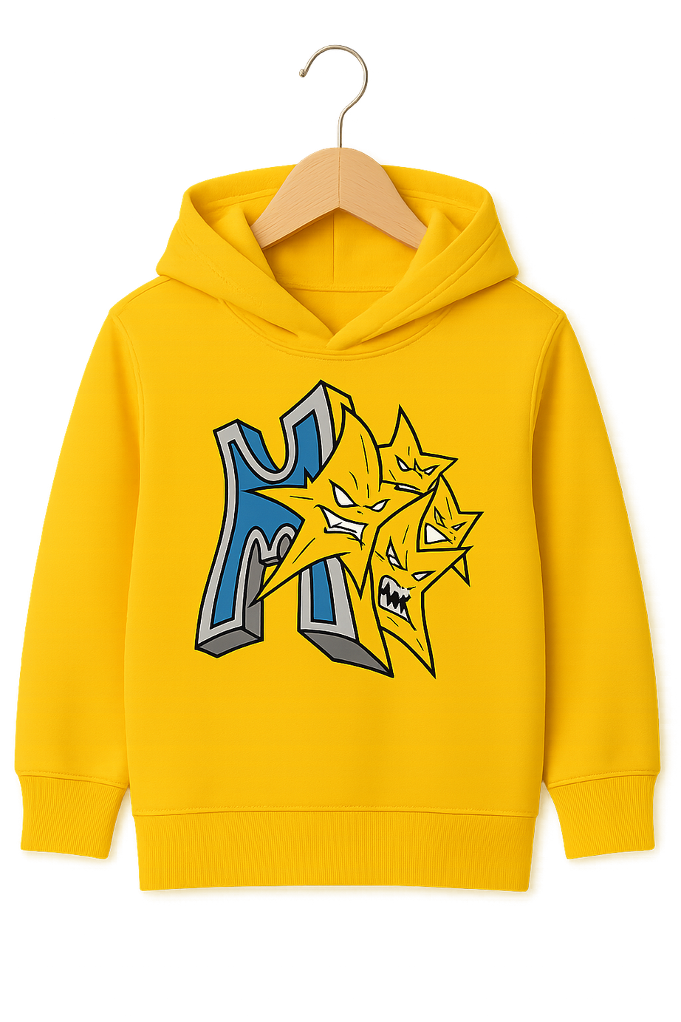
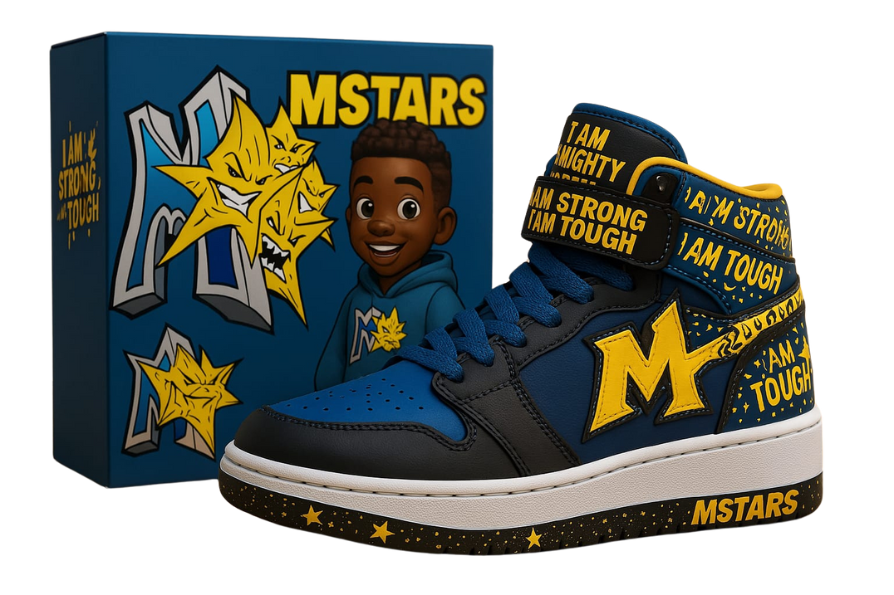
Brand Identity
MSTARS uses bold, vibrant visuals that feel both fun and powerful. The brand's voice is inspiring, playful, and affirming, aiming to connect with its target audience of children and empower them to embrace their uniqueness.
Notes:
9

Slide 9
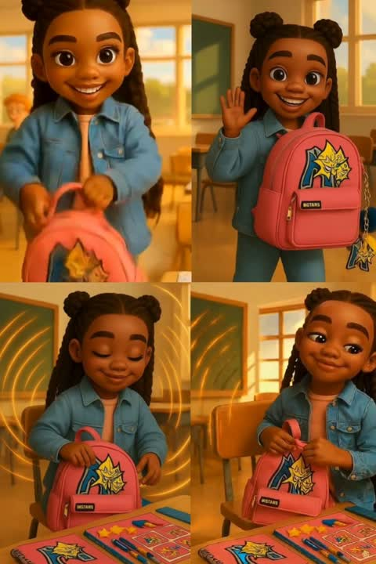
Core Values
Empowerment
Confidence
Empowering children to believe in their greatness & reach their full potential.
Building self-esteem & helping children feel proud of who they are.
Creativity
Inclusion
Fostering imaginative expression and celebrating the unique talents of each child.
Creating a welcoming and supportive environment for all children, regardless of their background or differences.
Representation
Ensuring children see themselves reflected in the brand and its messaging.
Notes:
7

Slide 10
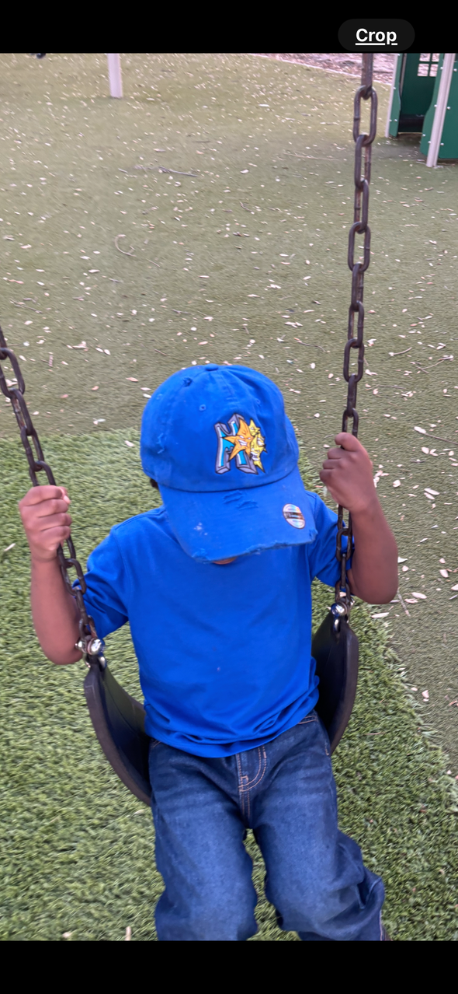
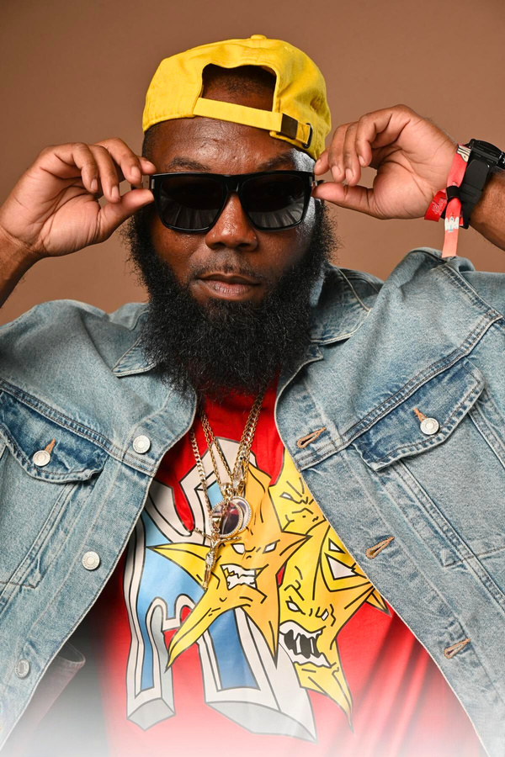
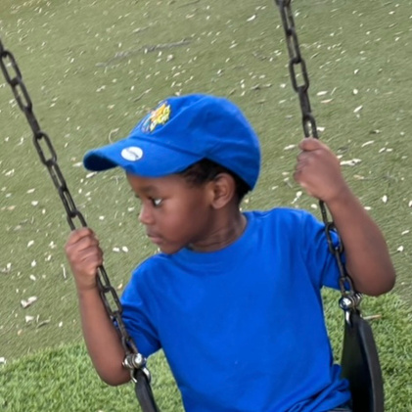
Target Audience
Primary Audience
Secondary Audience
Young school age
children ages 5-12
Younger siblings (2-5)
as well as parents,
educators, mentors, and community leaders who believe in empowering youth
MSTARS is focused on empowering and uplifting children, while also engaging with the broader community of supporters who can help amplify their positive message and mission.
Notes:
8

Slide 11
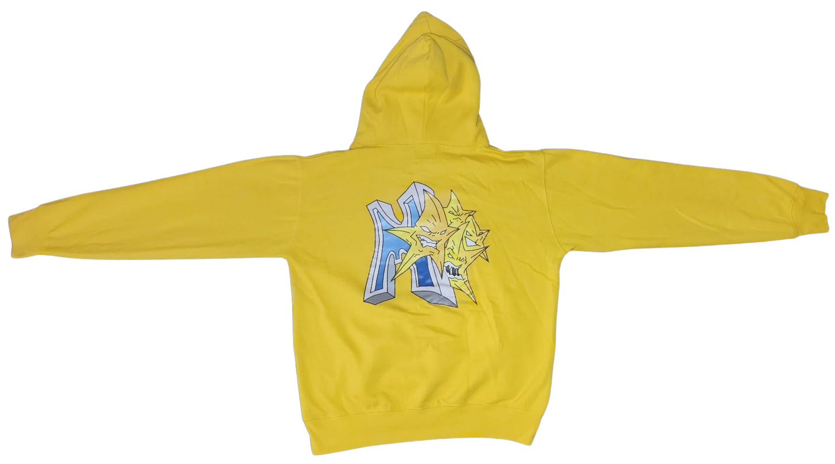
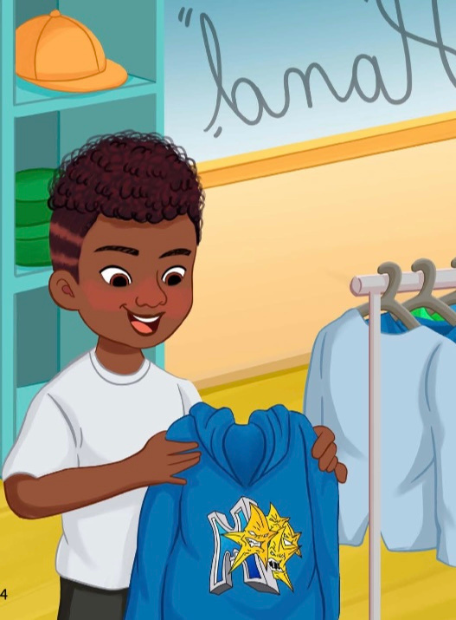
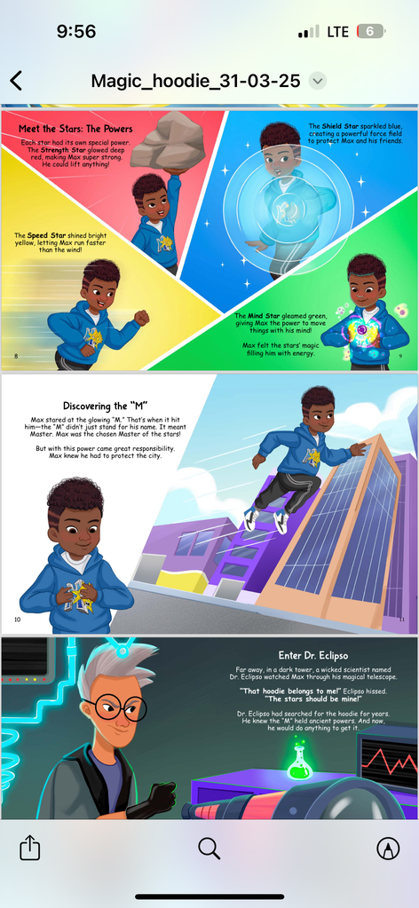
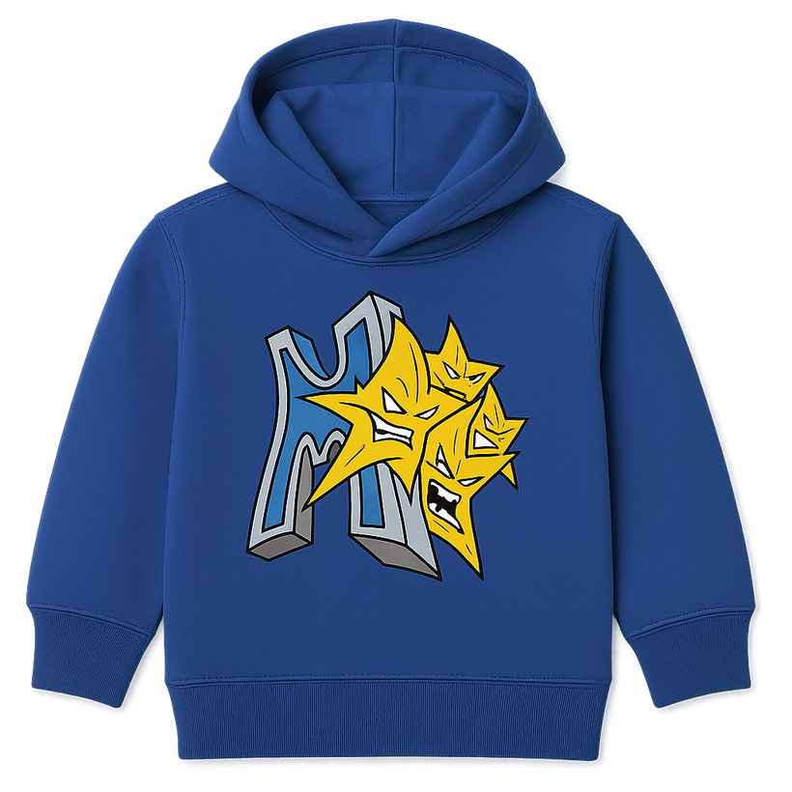
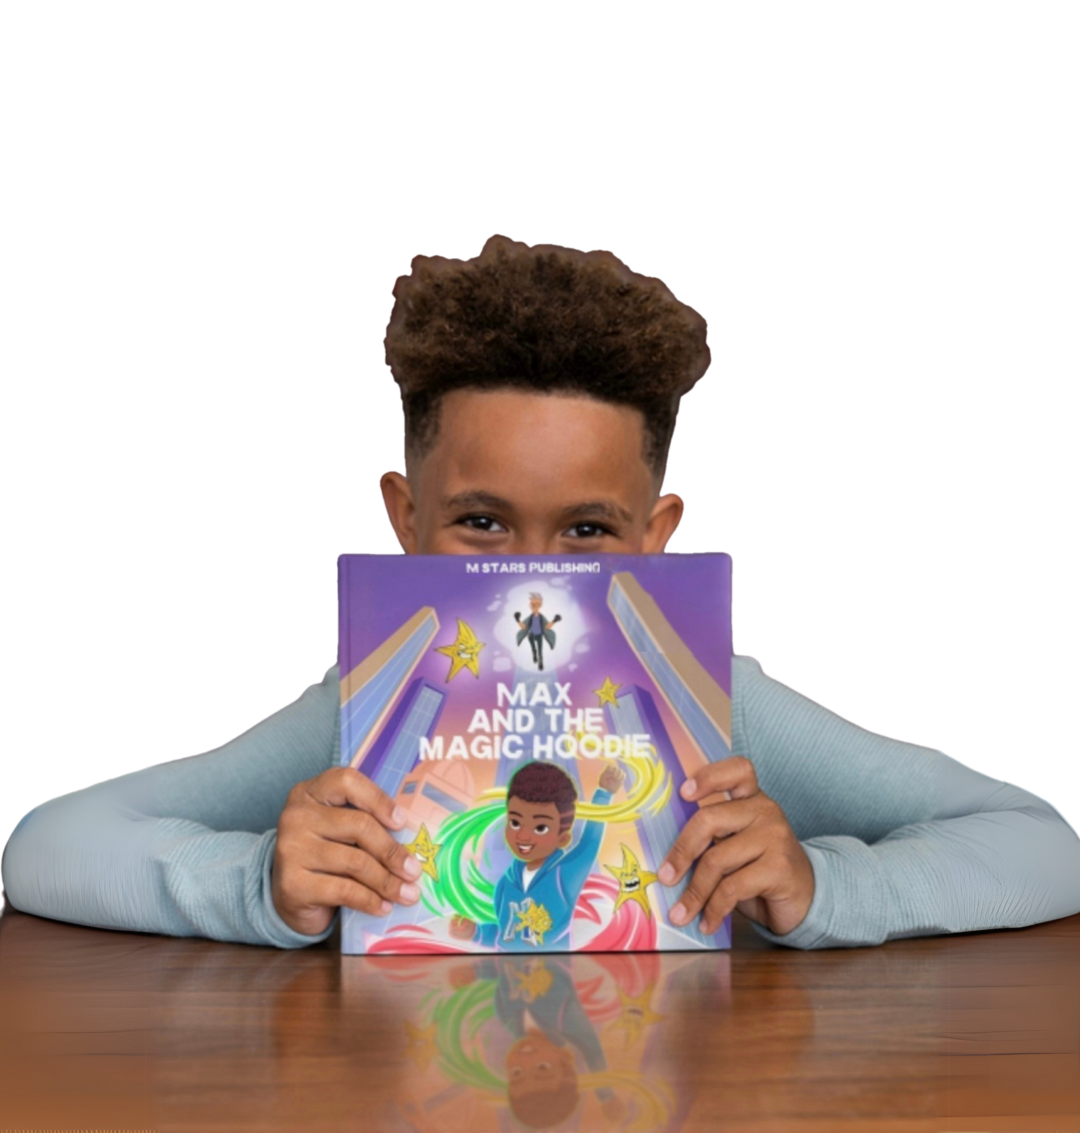

Featured Product
Book
+
Hoodie Bundle
t-shirts, hoodies, jackets, hats, scarves, jibbitz and more on the next page
Max and the Magic Hoodie
A story of self-belief, bravery, and transformation for young readers
Our featured product is the Book + Hoodie Bundle. Every book purchase comes with a
FREE hoodie so that the reader feels just as confident as the main character in the story.
The size range is from 2T all the way to 5XL so that no child feels left out.
Notes:
10

Slide 12
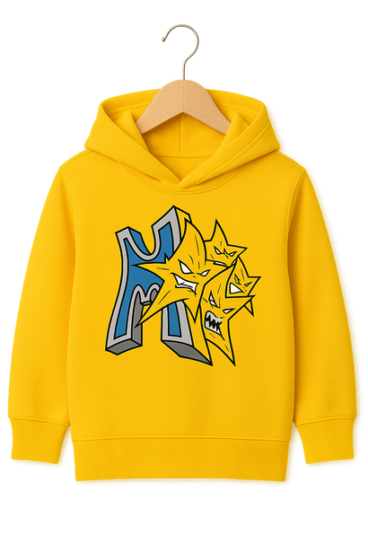
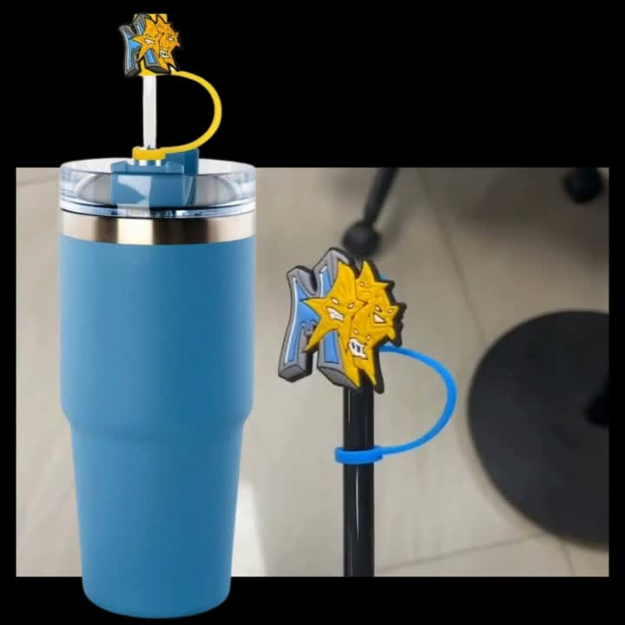
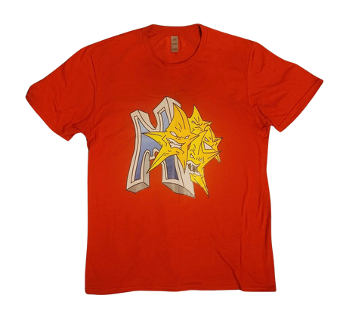
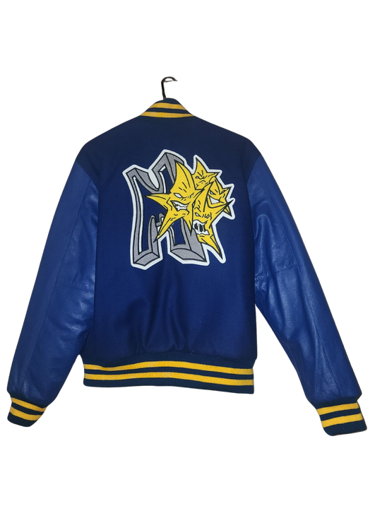
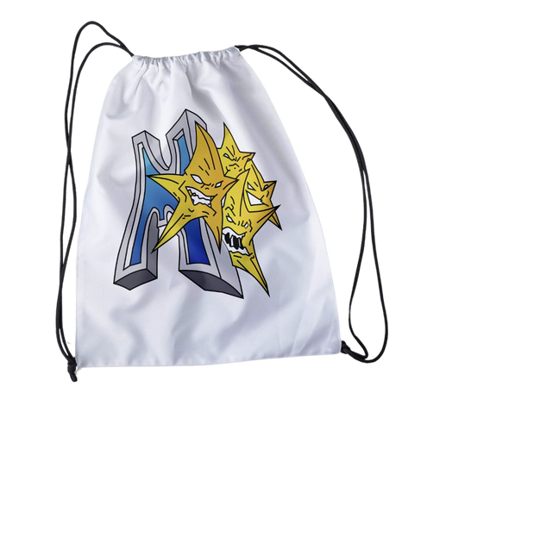
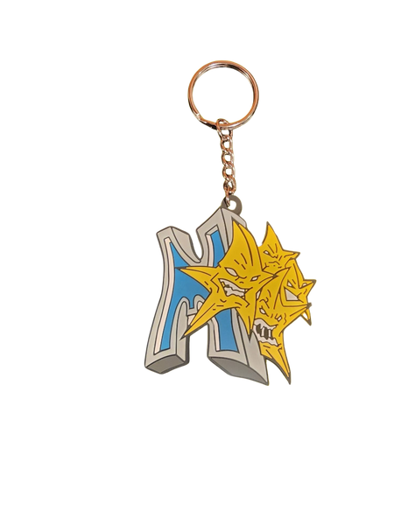
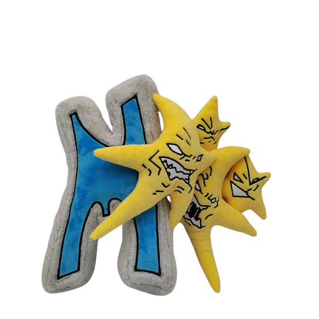
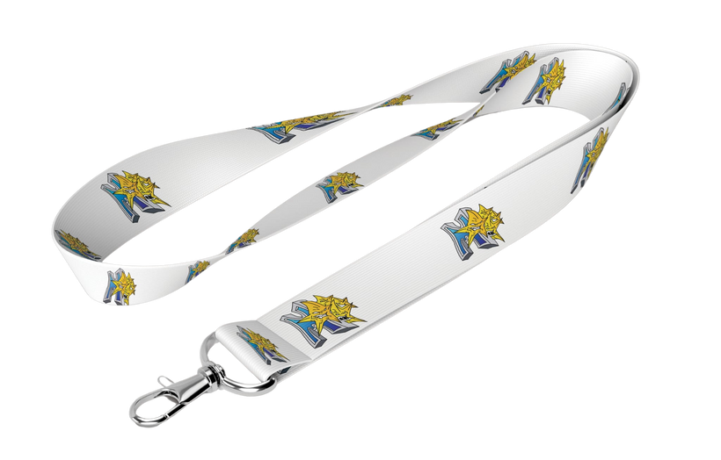
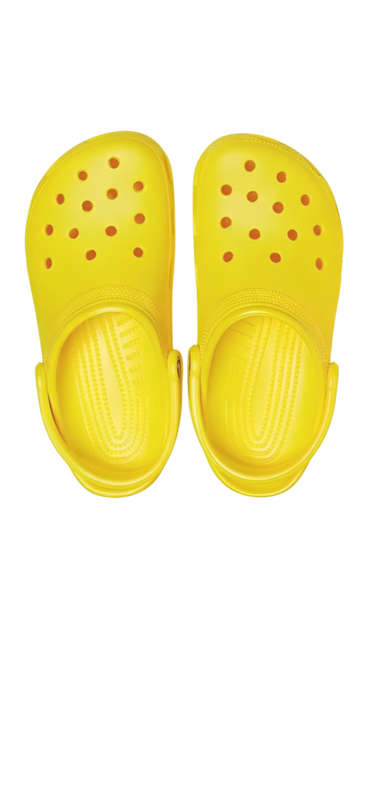
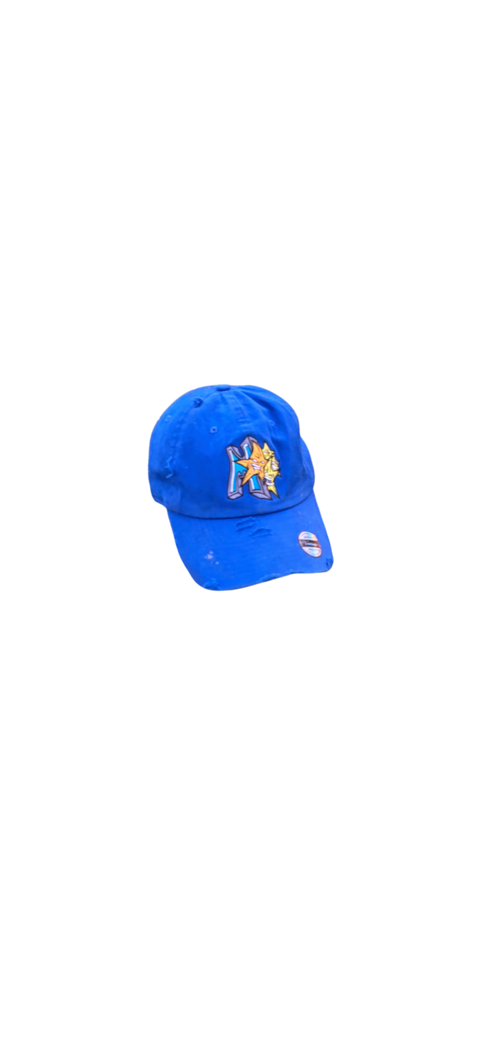
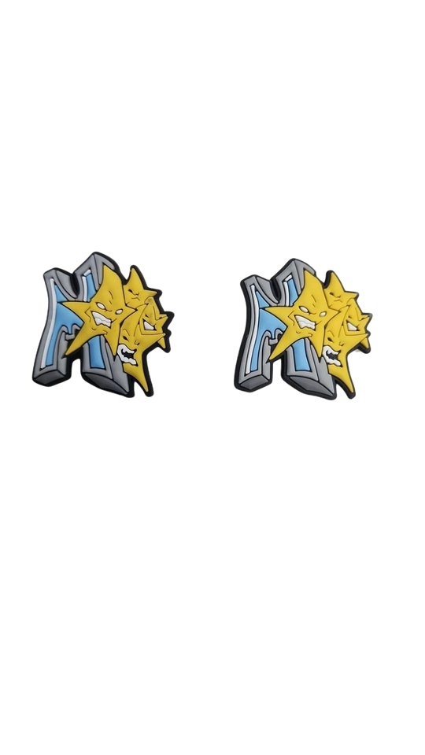
Current Product Line
T - SHIRTS
HOODIES
JACKETS
TUMBLERS
BACKPACKS
CROC STYLE JIBBITZ
HATS
KEY CHAINS
PLUSH TOYS
LANYARD
MSTARS offers a diverse range of products, from empowering apparel to inspiring
children's books, all designed to uplift and empower the next generation.
Notes:
10

Slide 13
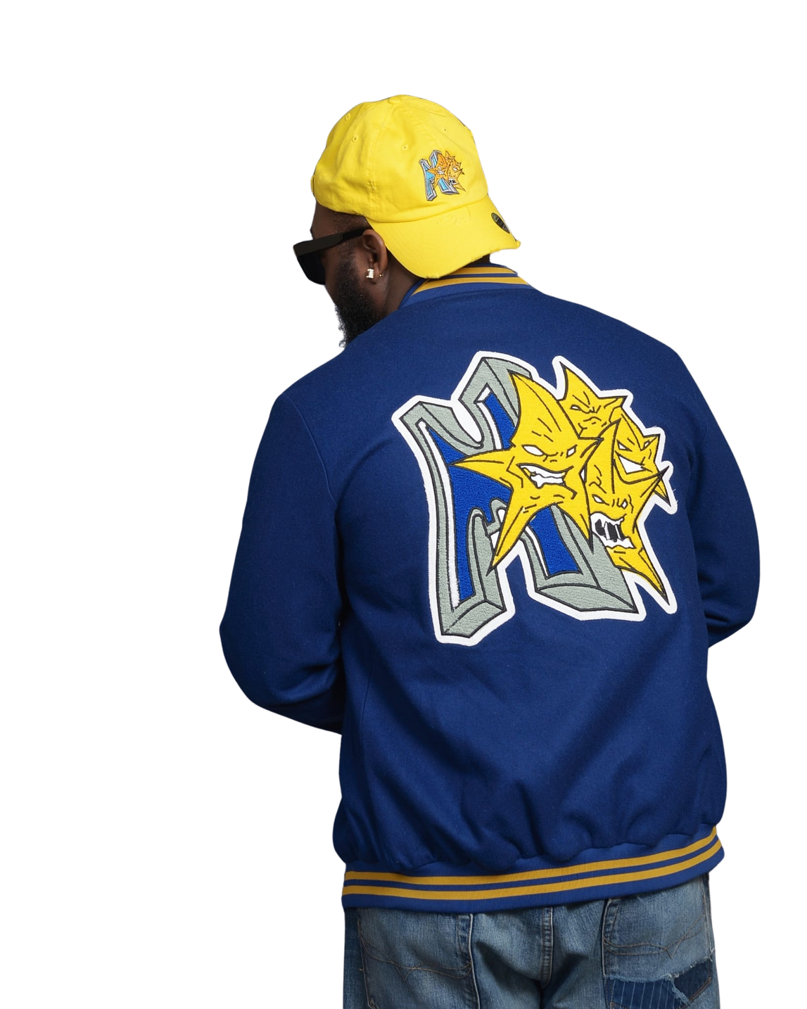
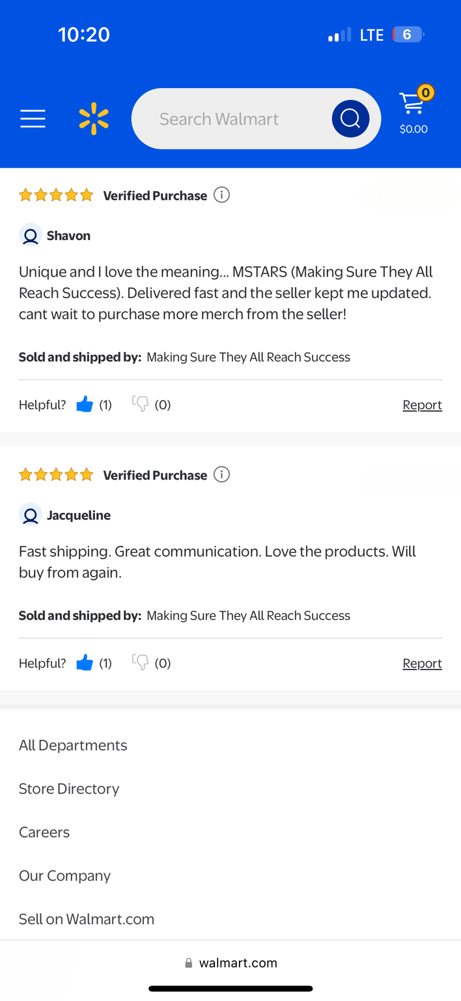
Momentum
Apparel line with empowering slogans
The MSTARS apparel collection features bold, confidence-boosting designs and slogans that resonate with the target audience.
Community buzz and positive feedback
The MSTARS brand has generated a lot of buzz and positive feedback from the community, indicating a strong reception and support for the brand's mission.
Book series growing in visibility
The MSTARS book series, starting with 'Max's and the Magic Hoodie', is gaining more attention and visibility in the market.
The MSTARS brand has gained significant momentum, with their diverse product offerings, including apparel, and books, resonating with their target audience. The positive community response and growing visibility of the brand's initiatives, including being featured on WALMART.com, are strong indicators of MSTARS' continued success and potential for further expansion.
Notes:
12

Slide 14
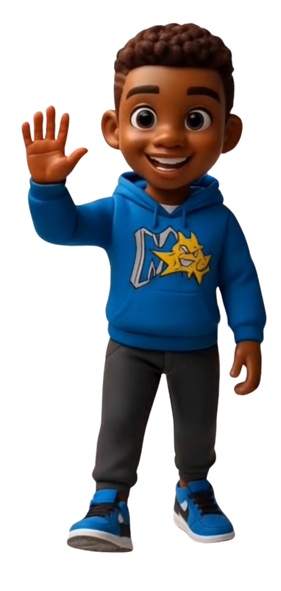
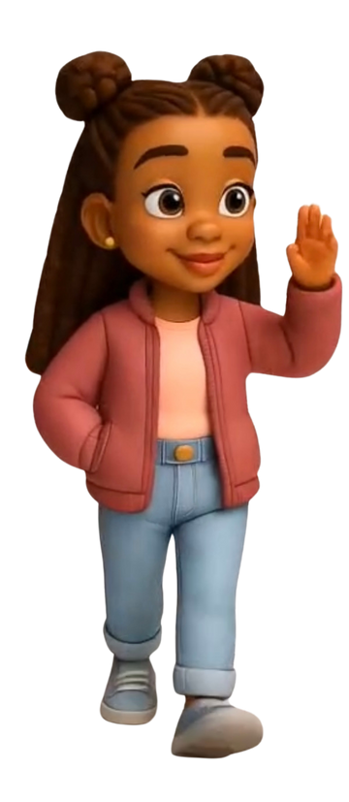
What We're Looking For
Licensing Agents & Manufacturers
Brand Collaborations
Opportunities to work with like-minded brands and influencers to create co-branded products, content, and experiences that amplify our mission.
Partners to help expand our apparel, toys, and other product lines through licensing agreements and manufacturing capabilities.
Investment to Scale & Amplify
Retail & Distribution Partnerships
Funding and strategic partnerships to help us scale our operations, marketing, and impact to reach more children and families in need of our empowering brand.
Relationships with retailers, wholesalers, and distributors to make our products available in more stores and reach a wider audience.
MSTARS is seeking strategic partners and investors who share our vision of empowering children of color and helping them reach their full potential. With the right collaborations and resources, we can expand our reach and deepen our impact to ensure that all children have the confidence and support they need to soar.
Notes:
14

Slide 15
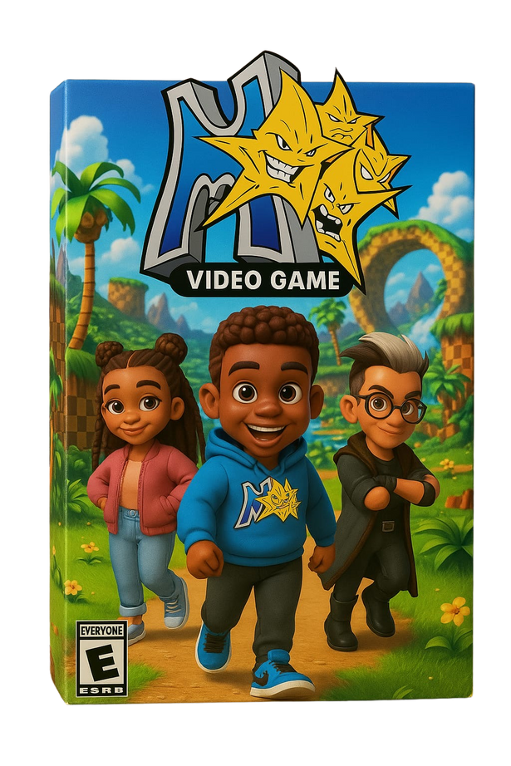
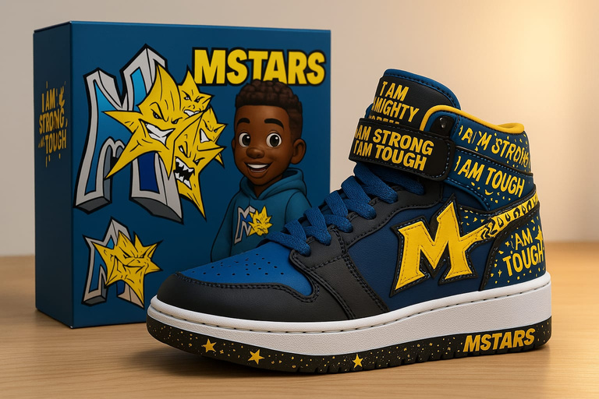
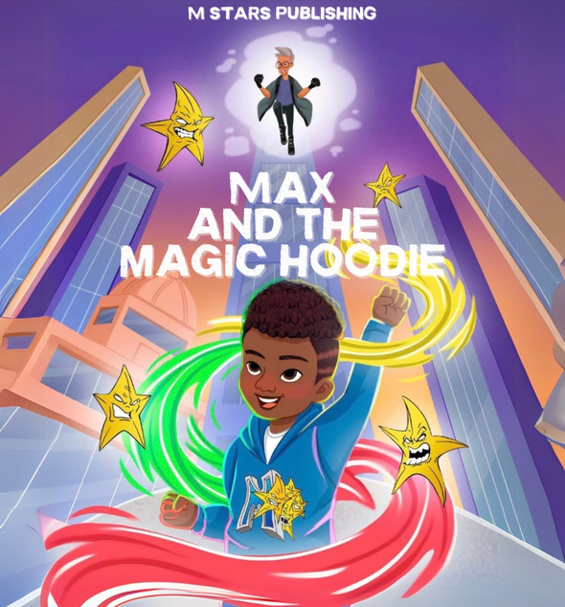
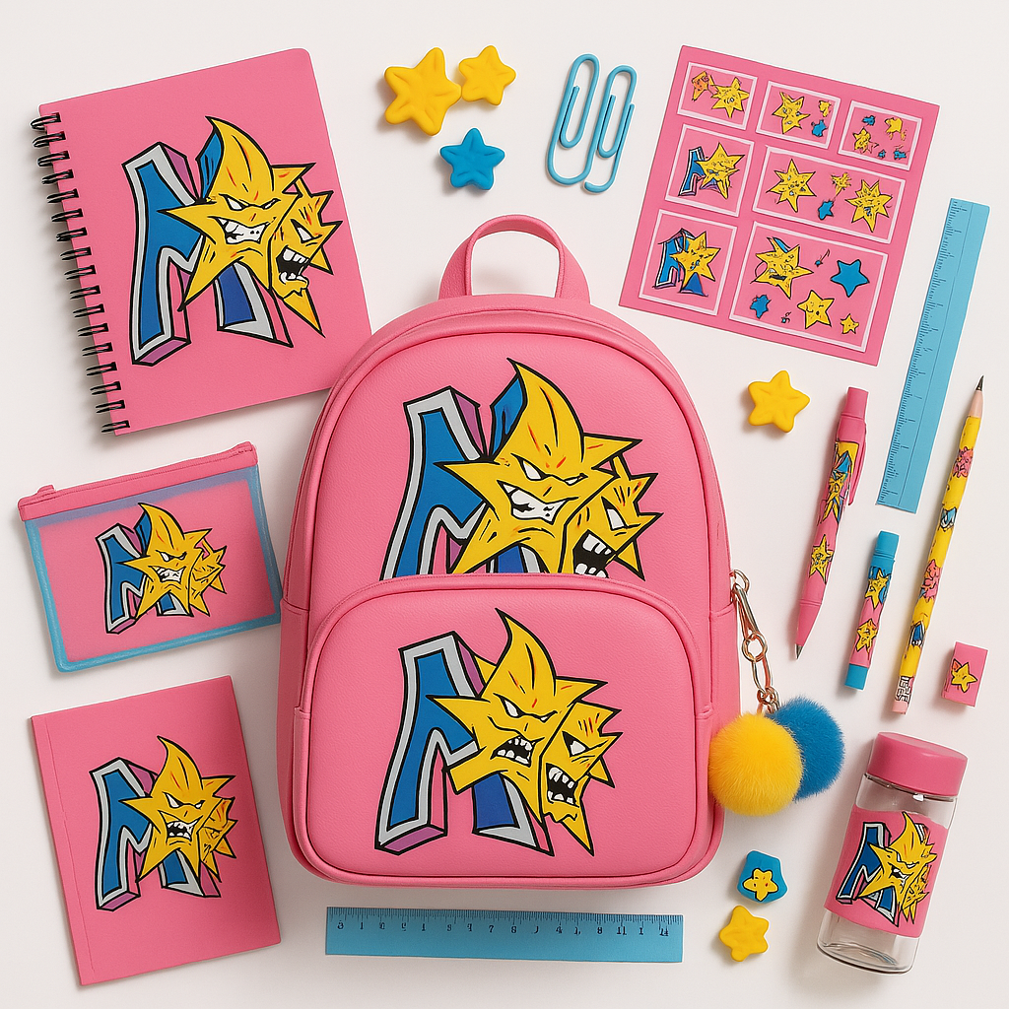
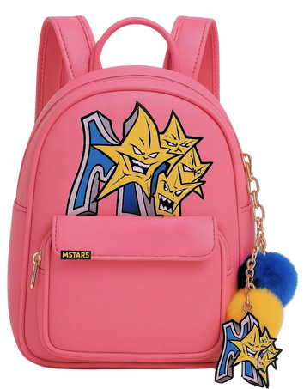
Licensing & Collaboration Opportunities
Apparel & footwear
  Expand MSTARS' empowering clothing line and explore footwear opportunities to further boost confidence and celebrate identity
Video Game, Cartoon, YouTube Content
  Develop engaging animated series, shows, or interactive games that bring the MSTARS brand and characters to life for children
Book publishing & education
  Collaborate on publishing more MSTARS-themed books and educational resources to promote self-belief, bravery, and transformation
Toys, Collectibles, School Supplies
  Create fun, educational MSTARS-branded toys, backpacks, notebooks, and other school essentials to inspire and empower kids
Notes:
13

Slide 16
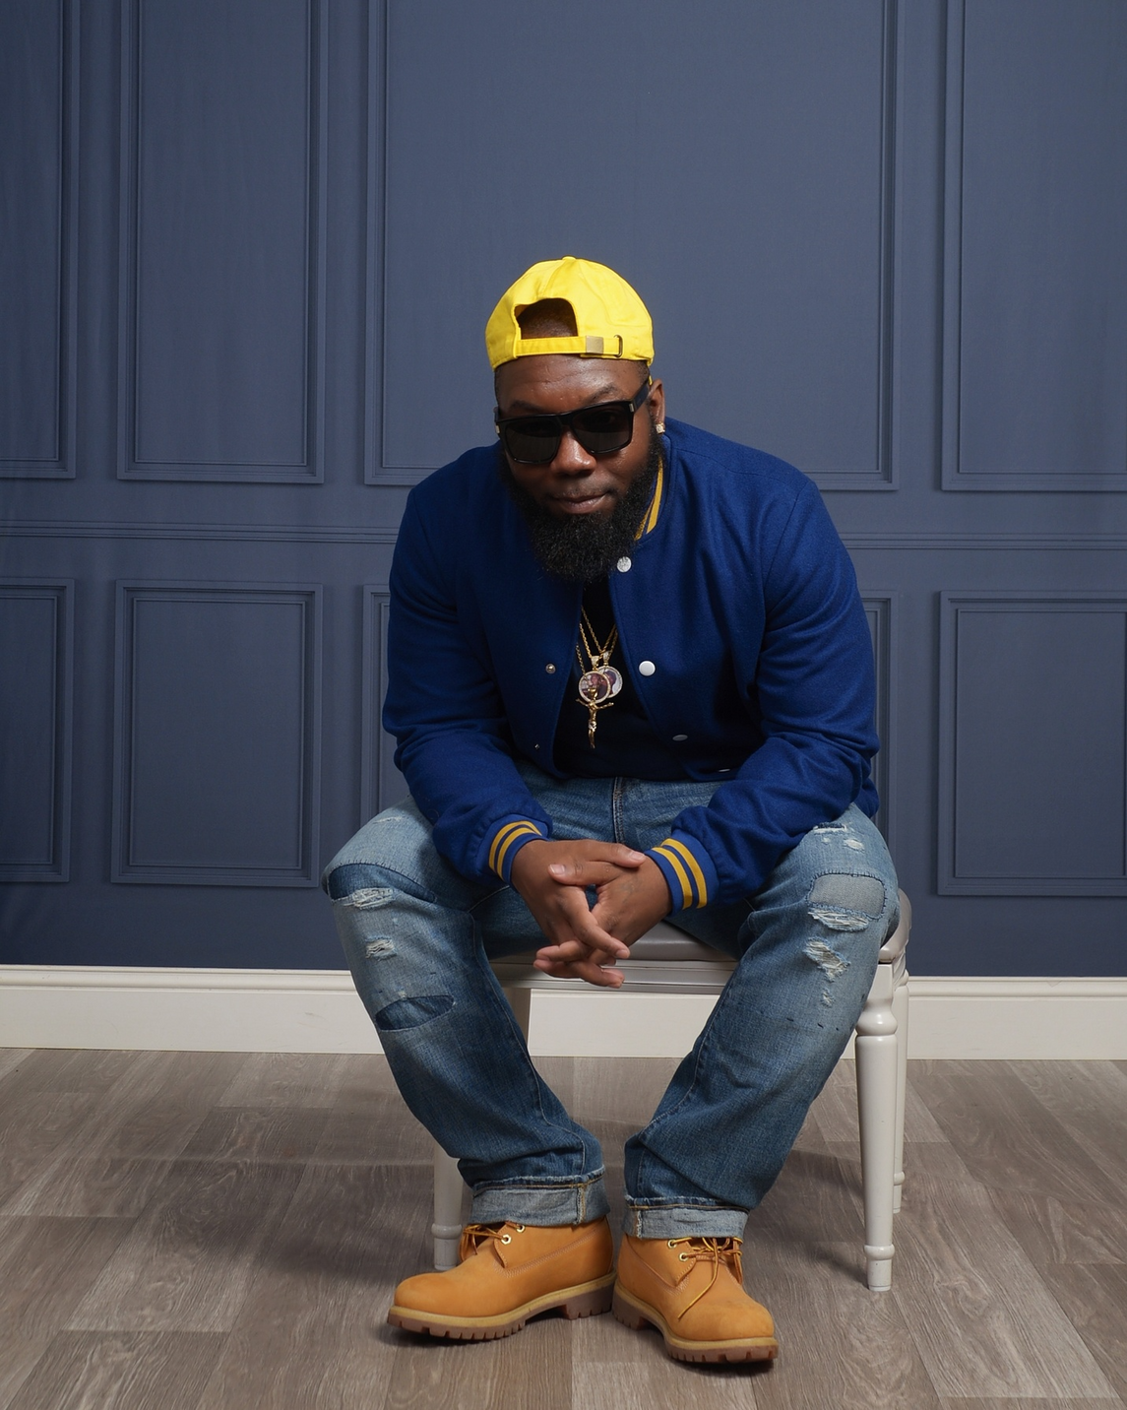
Shaun Armstrong
Founder, CEO & Visionary Behind MSTARS
I started MSTARS with one mission: to give every child who’s ever been overlooked the confidence to believe they belong. From shy kids to those labeled with ADHD, on the spectrum, or simply “too different,” MSTARS exists to show them they’re not broken — they’re brilliant.
Through powerful characters, bold storytelling, and confidence-driven products, I’m building a movement that uplifts the misfits and helps them shine. MSTARS isn’t just a brand — it’s a belief: that every child deserves to reach success and feel seen on the way there.
Come Fly With The Stars.
Notes:
15

Slide 17
MSTARS: Making Sure They All Reach Success
MSTARS is a promising brand that is making a meaningful impact on the lives of all children. With its strong brand identity, diverse product offerings, and clear vision for the future, MSTARS is well-positioned to continue expanding its reach and partnering with like-minded organizations to empower the next generation.
For all inquiries contact
Shaun Armstrong
347-520-4405
shaun@mstarsbrand.com
Notes:
16

